Slide 1


Slide 2

The Clapper
Clap-activated Switch

Slide 3
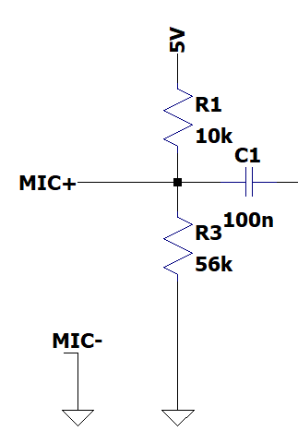
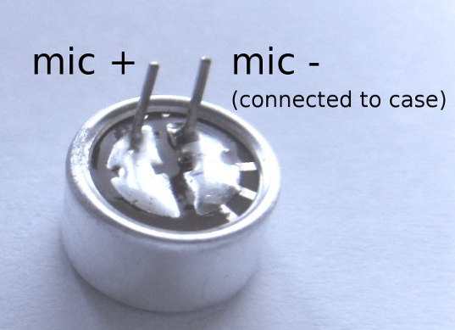
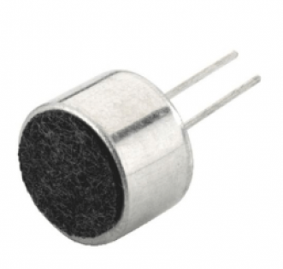
Microphone
Turns sound into voltage
Needs a bit of electronics to work properly
Capacitor to remove the DC part of the signal
Microphone has positive and negative terminal

Slide 4
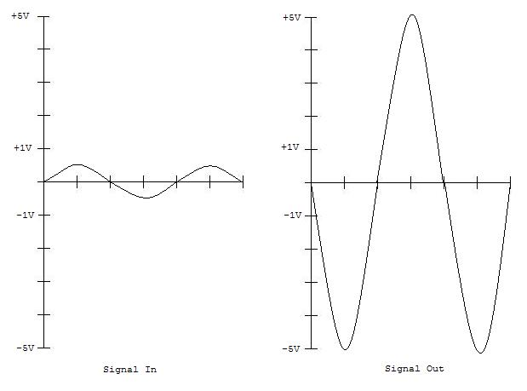
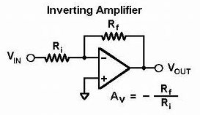
Amplifier

Slide 5
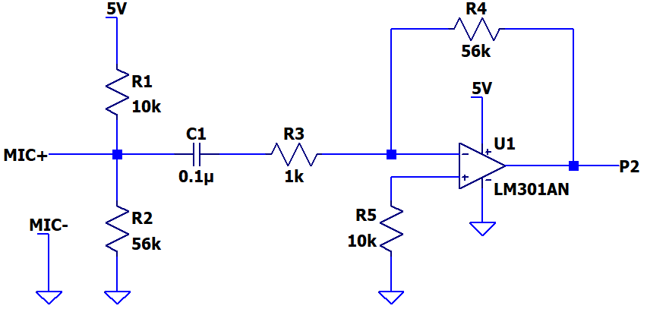
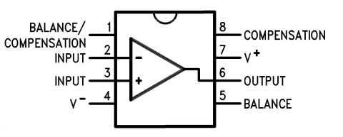
Microphone – Op Amp Circuit

